Slide 1

SQL Server
Arctech Info Private Limited

Slide 2
SELECT TOP
1) Using TOP with a constant value
SELECT TOP 10
product_name,
list_price
FROM
production.products
ORDER BY
list_price DESC;
2) Using TOP to return a percentage of rows
SELECT TOP 1 PERCENT
product_name,
list_price
FROM
production.products
ORDER BY
list_price DESC;

Slide 3
SELECT TOP
3) Using TOP WITH TIES to include rows that match the values in the last row
SELECT TOP 3 WITH TIES
product_name,
list_price
FROM
production.products
ORDER BY
list_price DESC;

Slide 4
Filtering data
Distinct
select distinct values in one or more columns of a table.
Where
filter rows in the output of a query based on one or more conditions.
AND
combine two Boolean expressions and return true if all expressions are true.
OR
combine two Boolean expressions and return true if either of conditions is true.
IN
check whether a value matches any value in a list or a subquery.
Between
test if a value is between a range of values.
Like
check if a character string matches a specified pattern.
Column & table aliases
show you how to use column aliases to change the heading of the query output and table alias to improve the readability of a query.

Slide 5
IN
The IN operator is a logical operator that allows you to test whether a specified value matches any value in a list.
SELECT product_name, list_price
FROM production.products
WHERE product_id IN (
SELECT product_id
FROM production.stocks
WHERE store_id = 1 AND quantity >= 30
)
ORDER BY product_name;
SELECT product_name, list_price
FROM production.products
WHERE list_price IN (89.99, 109.99, 159.99)
ORDER BY list_price;

Slide 6
BETWEEN
The BETWEEN operator is a logical operator that allows you to specify a range to test.
Syntax –
column | expression BETWEEN start_expression AND end_expression
SELECT product_id, product_name,
list_price
FROM production.products
WHERE
list_price BETWEEN 149.99 AND 199.99
ORDER BY
list_price;

Slide 7
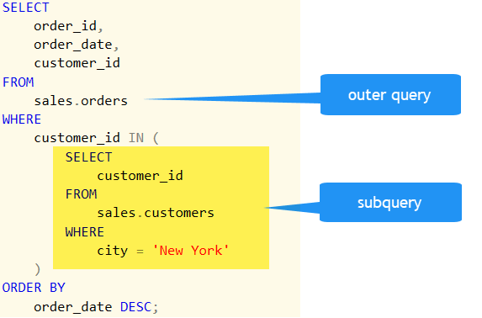
Subquery
Subquery –
A subquery is a query nested inside another statement .

Slide 8
Nesting subquery
A subquery can be nested within another subquery. SQL Server supports up to 32 levels of nesting.
Example –
Get all the product whoes list_price is more than the average price of product of brand 'Strider' or 'Trek'
1. get the brand id of bran names - 'Strider' or 'Trek'
2. get the average of list price whoes brand id falls in the above list
3. get all the products whoes list price is more than the average calculated above
SELECT product_name, list_price
FROM production.products
WHERE list_price > (
SELECT AVG (list_price) FROM production.products
WHERE brand_id IN (
SELECT brand_id FROM production.brands
WHERE brand_name = 'Strider'
OR brand_name = 'Trek'
)
)
ORDER BY
list_price;

